Slide 1
Eyewitness evidence of explosions in the Twin Towers
Graeme macqueen
Toronto Hearings
Sept 10, 2011

Slide 2
“the investigator should take into consideration all the available information, including witness statements.”
NFPA 921: Guide for Fire and Explosion Investigations (2004 Edition), 21.16

Slide 3
G. MacQueen, “118 Witnesses: The Firefighters’ Testimony to Explosions in the Twin Towers”
Journal of 9/11 Studies, 2006

Slide 4
3 main points
The conviction that the Towers came down because of explosions was common on 9/11.
There is substantial eyewitness evidence supporting this conviction.
This eyewitness evidence has been ignored or suppressed by the 9/11 Commission and the National Institute of Standards and Technology (NIST).

Slide 5
The conviction that the Towers came down because of explosions was common on 9/11.

Slide 6
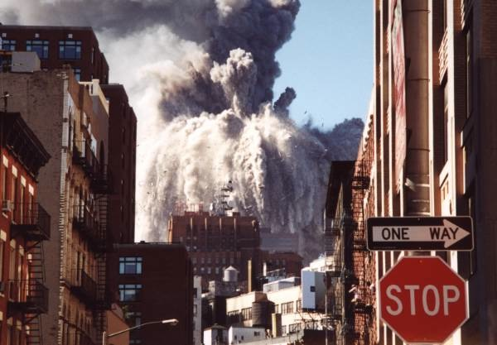

Slide 7
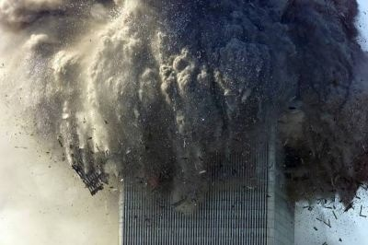
Photo Album

Slide 8
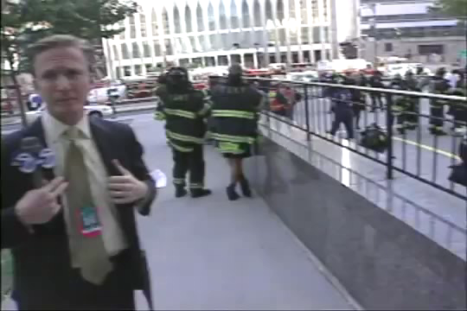
South Tower

Slide 9
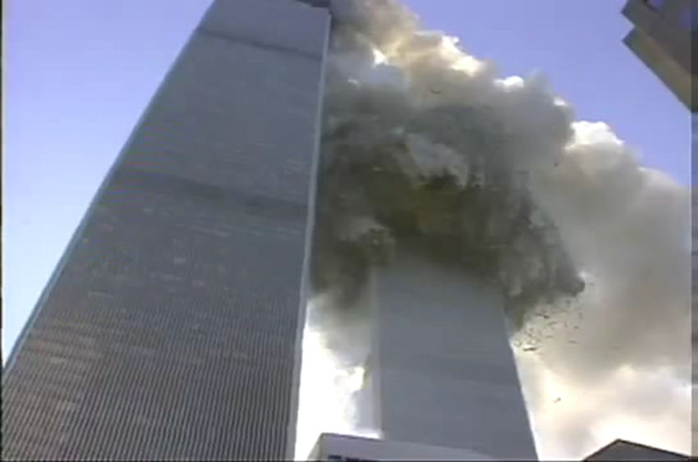
“a HUGE explosion now, raining debris on all of us.
We better get out of the way!”

Slide 10
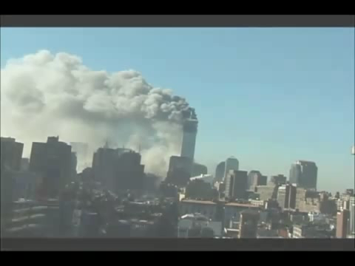
Matthew Shapoff video

Slide 11
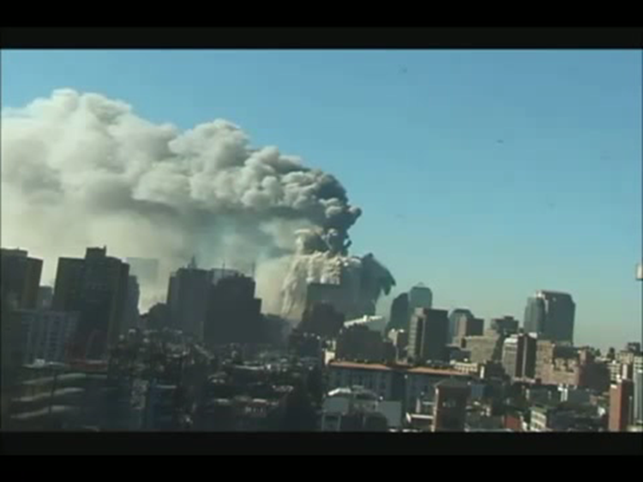
“That was a bomb that did that!”

Slide 12
Name of FBI’s 9/11 Investigation
PENTTBOM =
“Pentagon/Twin Towers Bombing Investigation”

Slide 13
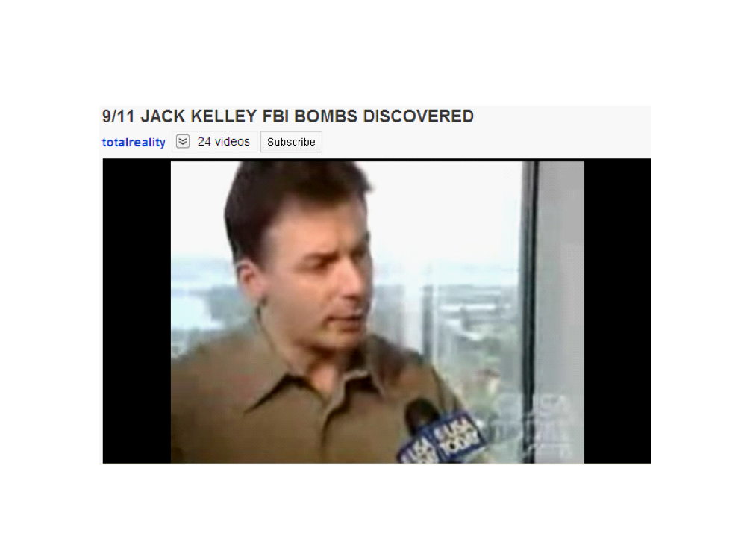
Jack Kelley on USA Today, Sept. 11, 2001

Slide 14
There is substantial eyewitness evidence supporting the explosion hypothesis.
(1) Quality
(2) Quantity

Slide 15
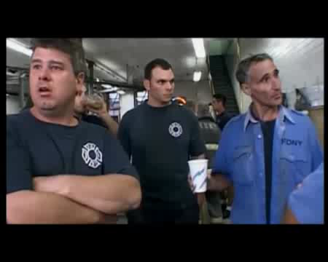
Clip from Naudet film

Slide 16
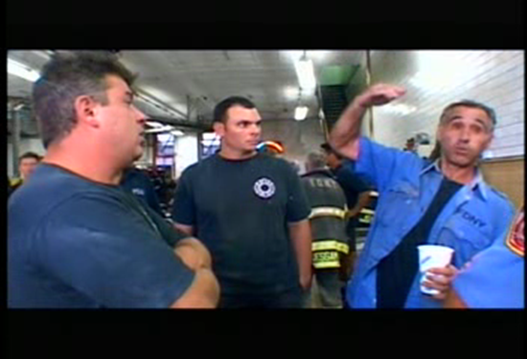
Tardio

Slide 17
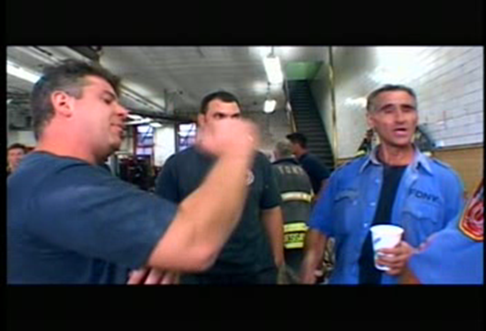
Zoda

Slide 18
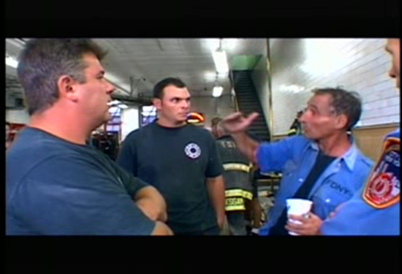
Tardio

Slide 19
Zoda: (moving hand) “Floor by floor, it started poppin’ out.”
Tardio: (moving hand) “It was as if they had detonated, detonated, you know, as if they were planted to take down a building: boom, boom, boom, boom, boom, boom, boom.”
Zoda: “Yeah.”
Source: 9/11. Documentary film by Jules and Gedeon Naudet, footage captured 9/11/01

Slide 20
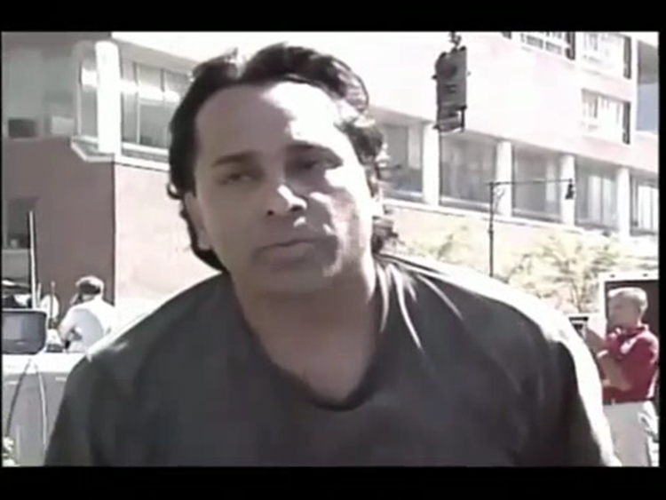
Paul Lemos

Slide 21

Lemos statement

Slide 22
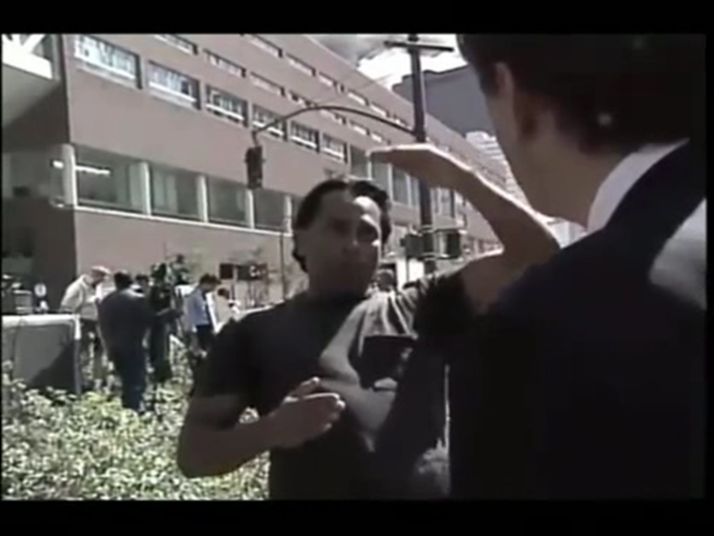

Slide 23
“All of a sudden I looked up and about twenty stories below…the fire…I saw, from the corner, boom, boom, boom, boom, boom, boom, boom, boom, boom…just like twenty straight hits, just went down and then I just saw the whole building just went ‘pshew’…and as the bombs were goin’ people just started running and I sat there and watched a few of ‘em explode and then I just turned around and I just started running for my life because at that point the World Trade Center was coming right down…”

Slide 24
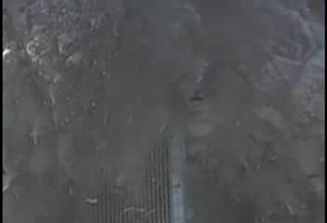
North Tower corner

Slide 25
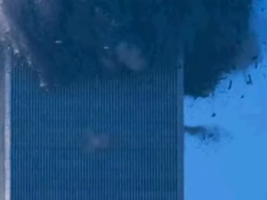
Ejections from the North Tower

Slide 26
6 Explosion Characteristics + Sue Keane’s Testimony
1. Sound
“A couple of minutes later, it sounded like bombs going off. That’s when the explosions happened.”

Slide 27
2. Positive blast pressure phase
“The windows blew in…we all got thrown.”
“Each one of those explosions picked me up and threw me.”

Slide 28
3. Partial vacuum during positive blast pressure phase
“There was this incredible rush of air, and it literally sucked the breath out of my lungs.”

Slide 29
4. Negative blast pressure phase
“Everything went out of me with this massive wind…Stuff was just flying past. Then it stopped and got really quiet, and then everything came back at us. I could breathe at this point, but now I was sucking all that stuff in, too. It was almost like a back draft. It sounded like a tornado.”

Slide 30
5. Incendiary or thermal effect
“…he threw me under the hose, which in a way felt great, because I didn’t realize until then that my skin was actually burning. I had burn marks, not like you’d have from a fire, but my face was all red, my chest was red.”

Slide 31
6. Fragmentation and shrapnel
“…there was stuff coming out of my body like you wouldn’t believe. It was like shrapnel. It’s still coming out.”

Slide 32
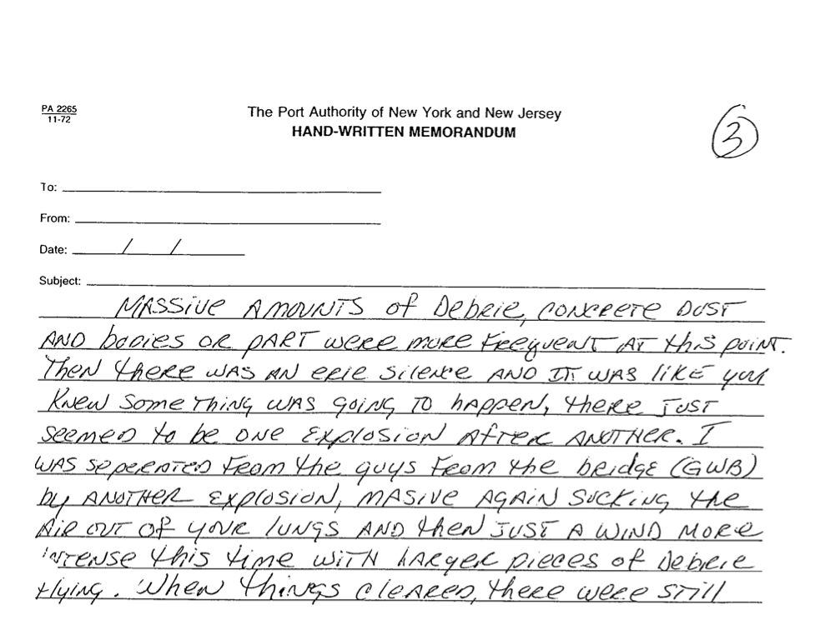

Slide 33
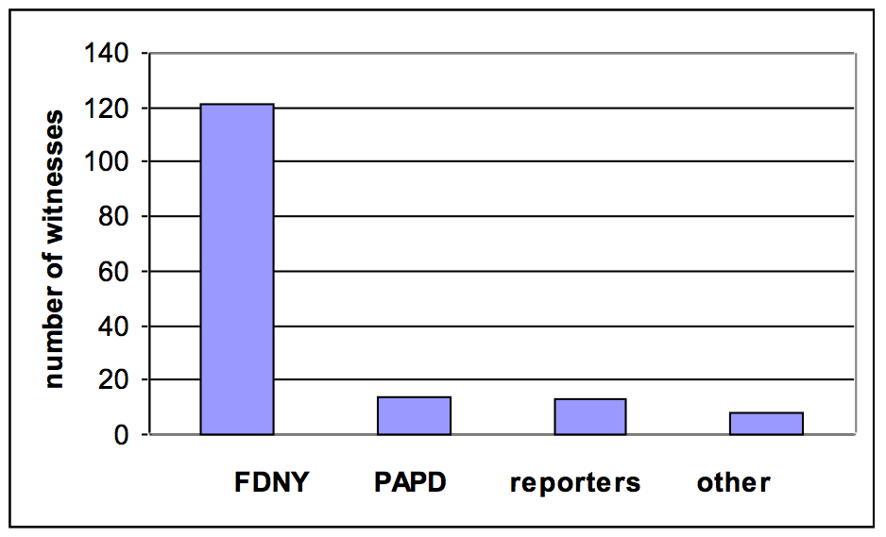
156 eyewitnesses by profession

Slide 34
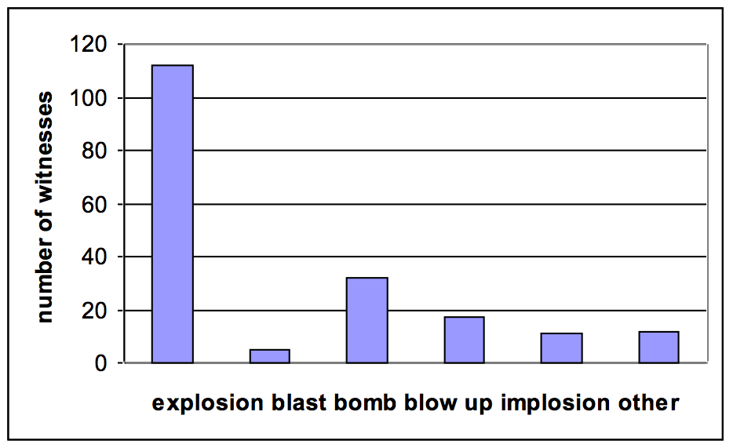
Terms used by witnesses

Slide 35
4 types of explosion not involving explosives
BLEVE (“boiling liquid expanding vapor explosion”)
Electrical explosion
Smoke explosion
Combustion explosion (e.g., natural gas, jet fuel vapor)

Slide 36
This eyewitness evidence has been ignored or suppressed by the 9/11 Commission and the National Institute of Standards and Technology (NIST).

Slide 37
9/11 Commission Report: sole reference
“…those firefighters not standing near windows facing south had no way of knowing that the South Tower had collapsed; many surmised that a bomb had exploded…”
The 9/11 Commission Report, p. 306

Slide 38
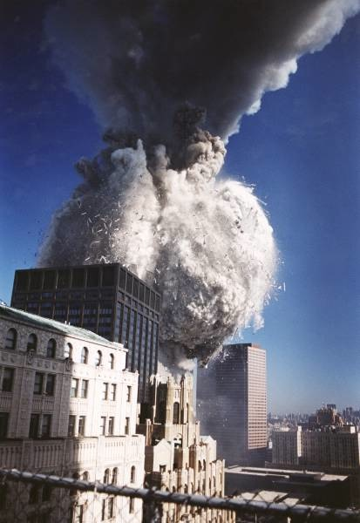
“I looked up, and the building exploded…The whole top came off like a volcano.”
Gary Gates, FDNY

