Slide 1
INDIA – LEGAL UPDATES
As on November 19, 2021
By: Adv. Dipali Ojha

Slide 2
BACKGROUND AND FACTS:-
1. As per Government of India, Covid-19 vaccination is NOT MANDATORY. It is voluntary. –However, various State Governments/Administrative officials have issued directions/circulars/orders for restricting entry for only vaccinated in order to avail public goods, access shopping malls, public transport etc.
2. At present there are three covid -19 vaccines in use in India (for adults) – COVISHIELD (known by name AstraZeneca in other countries), COVAXIN (indigenous vaccine) and Russia’s Sputnik.
3. EUA has been granted for Moderna, Johnson and Johnson and Zydus Cadila.

Slide 3
1. TWO PUBLIC INTEREST LITIGATIONS (PIL) FILED IN BOMBAY HIGH COURT AGAINST THE VIOLATION OF RIGHTS OF THE UNVACCINATED PEOPLE SUMMARY OF PRAYERS INCLUDED IN THE PILs:
(i) Strike down the SOPs and Notifications issued by Municipal Commissioner in so far as they discriminate with the people on account of their not being vaccinated, holding that the same are violative of Article 14, 19 and Article 21 of the Constitution of India
(ii) Amend Circulars/Directions/SOP to the extent by permitting non-vaccinated people to travel by train and they should not be treated differently than those who are vaccinated

Slide 4
(iii) Verify authenticity of RT-PCR tests in the light of information available and reproduced in the petition and also in the light of judgment given by the Portugal Court of Appeals in the case between Margarida Ramos De Almedia (1783/20.7TPDL.1-3) and then take a decision of relying on the test for taking decisions of lockdown or other restrictions.
(iv) Direct Respondents to not to check the healthy and Asymptomatic people and only check the people having symptoms.
The next date of hearing is November 22, 2021.
Links to access copies of Petitions:
https://indianbarassociation.in/wp-content/uploads/2021/09/yohan__tengra-Petition.pdf
https://indianbarassociation.in/wp-content/uploads/2021/08/Criminal-Writ-Petition-Railway-.pdf

Slide 5
2. PROMISING DEVELOPMENTS: MEDICAL EXEMPTION IS ALLOWED IN STATE OF MAHARASHTRA FOR THOSE WHO CANNOT TAKE THE VACCINE.
Link: https://timesofindia.indiatimes.com/city/mumbai/all-students-below-18-will-now-be-allowed-on-mumbai-local-trains/articleshow/87033707.cms

Slide 6
3. THE DEFINITION OF VACCINATED PERSON NOW INCLUDES;
1. Any person who has received both doses of vaccination and 14 days having lapsed since the administration of the second dose of the vaccine.
2. Any person having medical condition that does not allow him or her to take the vaccine and has a certificate to that extent from a recognized Doctor.
3. If person is of age less than 18 years. (in the future when vaccine becomes available for this age group than this will continue for first 60 days of such availability.)
COPY OF RAILWAY’S CIRCULAR

Slide 7
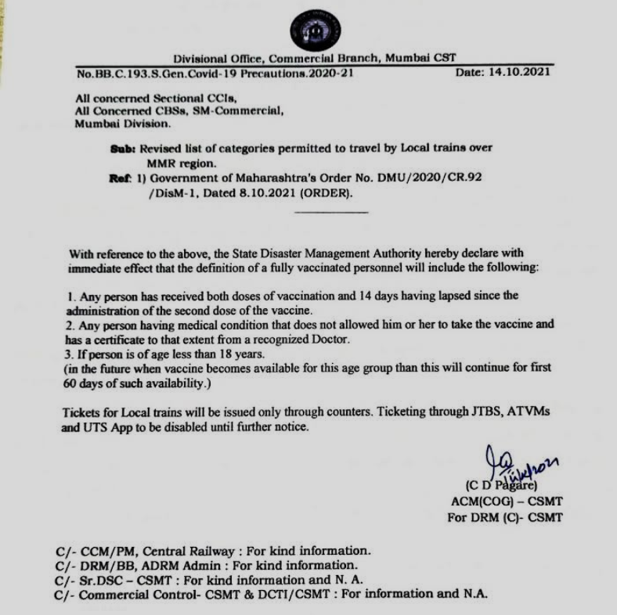

Slide 8
4. CONFLICTS OF INTERESTS OF PERSONS IN NATIONAL COVID-19 TASKFORCE REVEALED BY INDEPENDENT RESEARCHER MR. YOHAN TENGRA
Link to access the article dated 27th September, 2021:
https://awakenindiamovement.com/indias-covid-19-task-force-experts-exposed-conflicts-of-interest-in-our-public-health-system/
https://davidicke.com/2021/09/28/ndias-covid-19-task-force-experts-exposed-conflicts-of-interest-in-our-public-health-system/ https://healthimpactnews.com/2021/awaken-india-exposes-billionaire-cartel-controlling-indias-covid-19-task-force/

Slide 9
THIS ARTICLE ALSO COVERS:
How task Force members get the science on COVID-19 totally wrong, which proves that their conflicts are influencing their recommendations.
India’s illegal HPV vaccine trials, role of Indian Council of Medical Research (ICMR).
How Bill & Melinda Gates Foundation (BMGF) baby PHFI (Public Health Foundation of India) gets funding from vaccine manufacturers and how it holds deep influence in controlling India’s Health Policies.

Slide 10
5. BASED ON ABOVE RESEARCH FINDINGS, INDIAN BAR ASSOCIATION HAS ISSUED A 223 PAGE LEGAL NOTICE TO HEALTH MINISTER MR. MANSUKH MANDAVIYA
Link to access the copy of Legal Notice:
https://indianbarassociation.in/wp-content/uploads/2021/09/Legal-Notice-to-Mr.-Mansukh-Mandviya.pdf
IBA has called upon the Hon’ble Health Minister to remove the persons/bureaucrats, members of the Task Force etc. from any decision-making process related with remedies and solutions regarding Covid-19 pandemic, who are directly or indirectly connected with any entity, NGO or Board that receives funds from Bill & Melinda Gates Foundation, Rockefeller Foundation, PATH, PHFI, where sole agenda is to reap profits for the vaccine manufacturers

Slide 11
Issue immediate direction as per law laid down by the Constitution Bench of Hon’ble Supreme Court in the case of Mineral Development Ltd. Vs State (1960) 2 SCR 609, there by directing to all authorities not to follow, the illegal, unconstitutional, unscientific and nonsensical circulars and orders based on the recommendations and suggestions regarding vaccination, masks, RT-PCR test etc., issued by these disqualified members;
Issue directions for forthwith removal and withdrawal of all the false, misleading and illegal advertisements, caller tunes, Questions and Answers (FAQs) published by the Ministry of Health and Family Welfare on the basis of recommendations given by members who are in the disqualified category as per law laid down by Hon’ble Supreme Court.
Immediate direction to protect the rights of covid cured citizens who are safest person as their immunity is proved to be 13 times better than fully vaccinated people and the citizen who are covid cured or having natural immunity developed due to contract with corona are entitled for relief from covid appropriate behavior before vaccinated people.

Slide 12
Issue directions for enquiry and then issue specific directions to all the authorities to not to allow to take part in any of the meetings or decision making process the following persons who are in the category of disqualified:
(i) Prof. K. Shrinath Reddy,
(ii) Dr. Cherry Gagandeep Kang,
(iii) Dr. Balram Bhargava,
(iv) Shri. V.K. Paul,
(v) Dr. Soumya Swaminathan ,
(vi) Dr. Randeep Guleria,
(vii) Dr. K. Vijay Raghvan,
(viii) Dr. N.K. Arora ;
and others as mentioning in para 14 of this notice.

Slide 13
Direction to prohibit the members of ICMR, PATH, PHFI, Bill Gates etc., who were found prima facie guilty by the Parliamentary committee in 72nd Report and based on the evidences given in this notice from participating in any board or body dealing with the corona management.
Direct prosecution u/s 51(b) of Disaster Management Act, 2005 against all the entities and all the persons who are directly or indirectly forcing the people to take vaccines or restricting their entries on the ground of non-vaccination.
Directions to authorities to not to publish misleading advertisements, slogans and publish correct facts that vaccines are not completely safe but many have side effects and vaccines are not the solution or there is no guarantee that citizens will not get corona and the person taking vaccine may die due to corona.
Directions to authorities to issue circulars to all State Governments and Central Government entities to not to conduct RTPCR/RAT Test of asymptotic and healthy persons.

Slide 14
Direction to authorities to not to draw any conclusions or not to take any policy decisions of lockdown or quarantine on the basis of RTPCR/RAT Test and only use the Gold Standard test of ‘Virus Culture’ for taking any policy decisions or recommendations etc.
Give directions to all authorities to issue circulars, advertisements et. al to make public aware that:
(a) Natural immunity caused due to Contract with Covid-19 is more than 13 times better than a fully vaccinated person and such people are most safest persons. They will not get corona again and they cannot spread infection.
(b) Wearing mask is voluntary and there is no scientific proof that masks can prevent infection. And the healthy or asymptomatic people need not to wear mask. Also publish the scientific studies regarding damage caused to the lungs and also other side effects of wearing masks.
Give wide publicity & proper support to the following result oriented remedies and treatments which are having far more efficacy than vaccines and not having no side effects with zero deaths as compared with many side effects and deaths due to vaccines:-

Slide 15
(i) Naturopathy’s - Three step Fluid Diet as formulated by Dr. Biswaroop Roy Choudhary and verified by National Institute of Naturopathy, Pune.
(ii) Anandia’s Ayurvedic ‘K’ medicine as verified & approved by the State Government of Andhra Pradesh and confirmed by the Hon’ble Andhra Pradesh High Court.
(iii) Ayurvedic & yoga treatment as suggested by Baba Ramdev.
Directions for forthwith stopping any marketing agenda, comments, advertisements regarding vaccination of Children as there is no need for vaccinating children, but marketing division of pharma companies are is trying to mislead the people at large.

Slide 16
6. (A) DOCTORS FOR TRUTH (MORE THAN 100 DOCTORS) AND MORE THAN 1000 MEMBERS OF CIVIL SOCIETY HAVE WRITTEN A LETTER TO HON’BLE PRIME MINISTER OF INDIA ON OCTOBER 7, 2021 REQUESTING NOT TO PROCEED WITH CHILDREN’S VACCINATION
(B) INDIAN BAR ASSOCIATION HAD SENT ITS LETTER OF REPRESENTATION ON OCTOBER 8, 2021 ASKING FOR CBI INVESTIGATION AND PROSECUTION OF CERTAIN PERSONS FOR THEIR MISUSE AND FARUD ON POWER IN:
(i) Giving Emergency Use Authorization for Children’s Vaccines, when there is no emergency as there is no serious threat to children;
(ii) Running false narratives and conspiracy theories to create fear in the mind of parents, children and teachers about Covid-19, when children are most safe and not having any serious risk from infection from SARS-CoV-2. Page 2 of 18 2.
(iii) Immediately directing investigation about corruption being done to give undeserving advantage of around Rs. 80,000 Crores to children’s Vaccine manufacturers.

Slide 17
(iv) Immediate direction for stopping any process for including children’s corona vaccines in National Immunization Programme.
Please access the IBA’s Letter of Representation on link below:
https://indianbarassociation.in/wp-content/uploads/2021/10/IBA-LETTER-TO-PM-08.10.2021-1.pdf
POSITIVE DEVELOPMENTS AFTER THIS LETTER

Slide 18
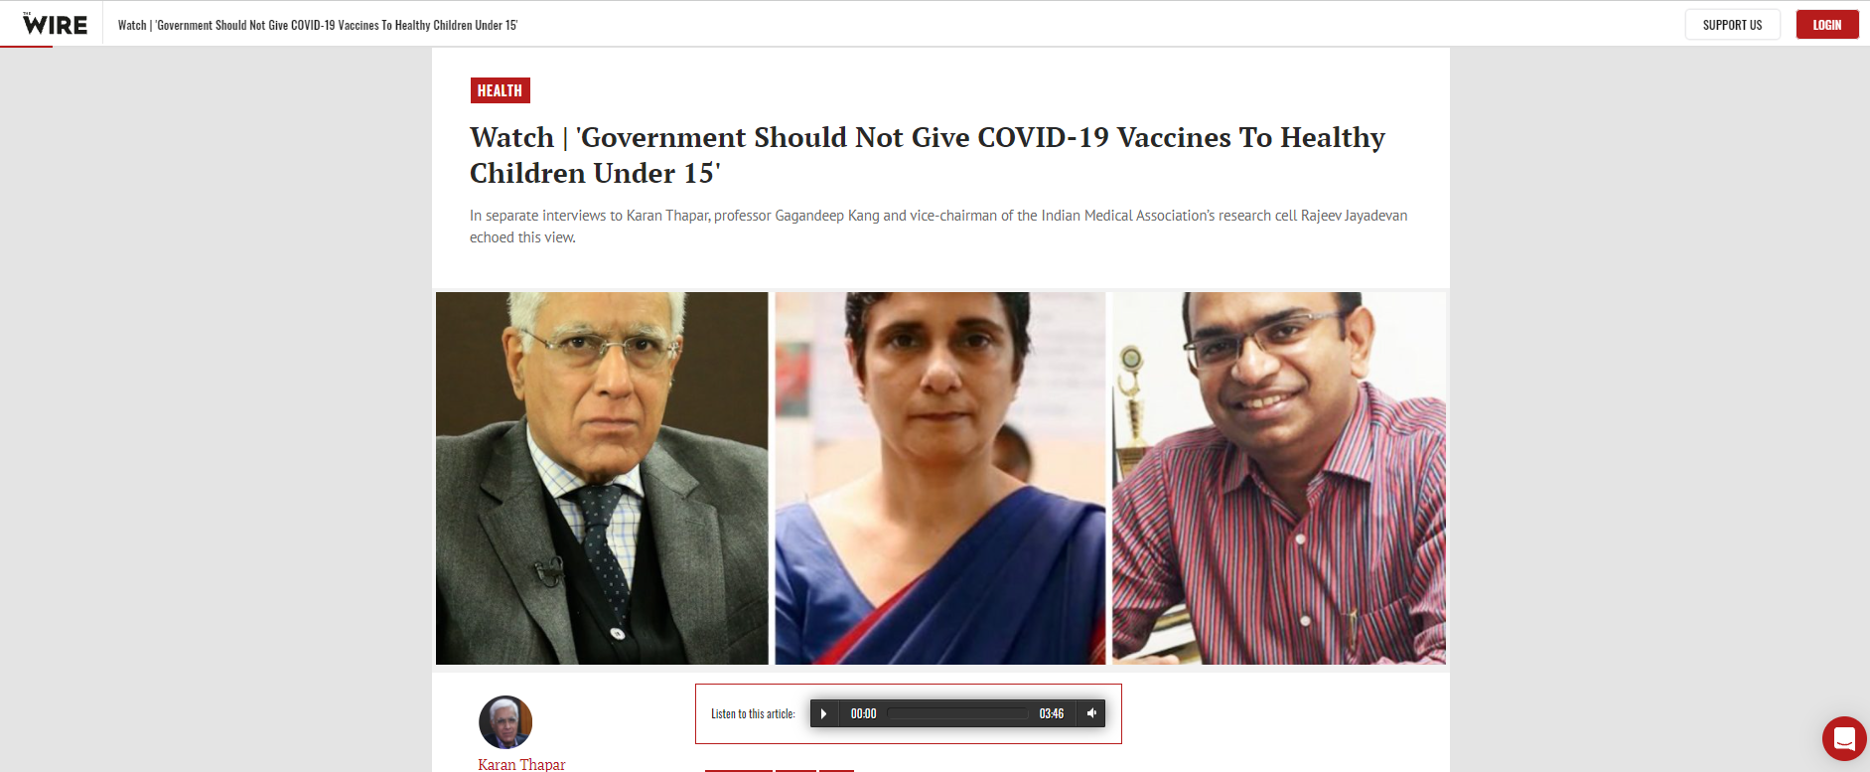
7. GOVERNMENT SHOULD NOT GIVE COVID-19 VACCINES TO HEALTHY CHILDREN UNDER 15.
https://thewire.in/health/watch-vaccine-healthy-children-under-15-covid-19-karan-thapar-gagandeep-kang-rajeev-jayadevan

Slide 19
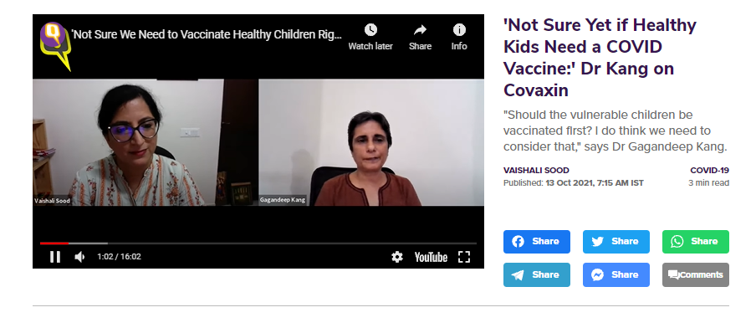
8. NOT SURE YET IF HEALTHY KIDS NEED A COVID VACCINE.
https://www.thequint.com/coronavirus/not-sure-yet-if-healthy-kids-need-a-covid-vaccine-dr-kang-on-covaxin-recommendation-for-children

Slide 20
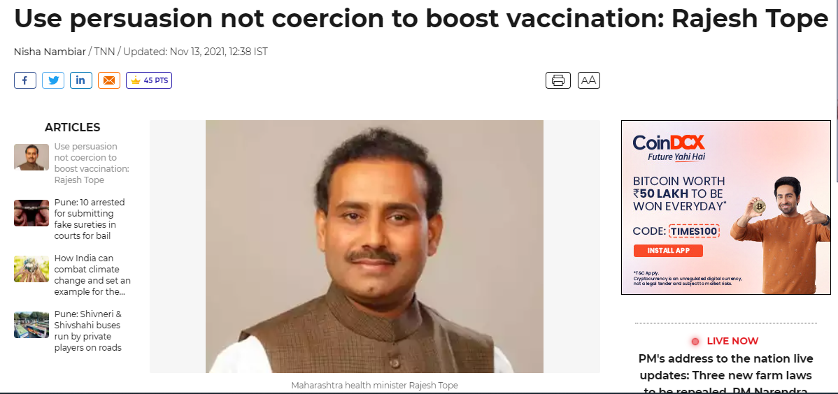
9. USE PERSUASION NOT COERCION TO BOOST VACCINATION: RAJESH TOPE, HEALTH MINISTER, STATE OF MAHARASHTRA
Link: https://timesofindia.indiatimes.com/city/pune/use-persuasion-not-coercion-to-boost-vaccination-in-mumbai-tope/articleshow/87674554.cms

Slide 21
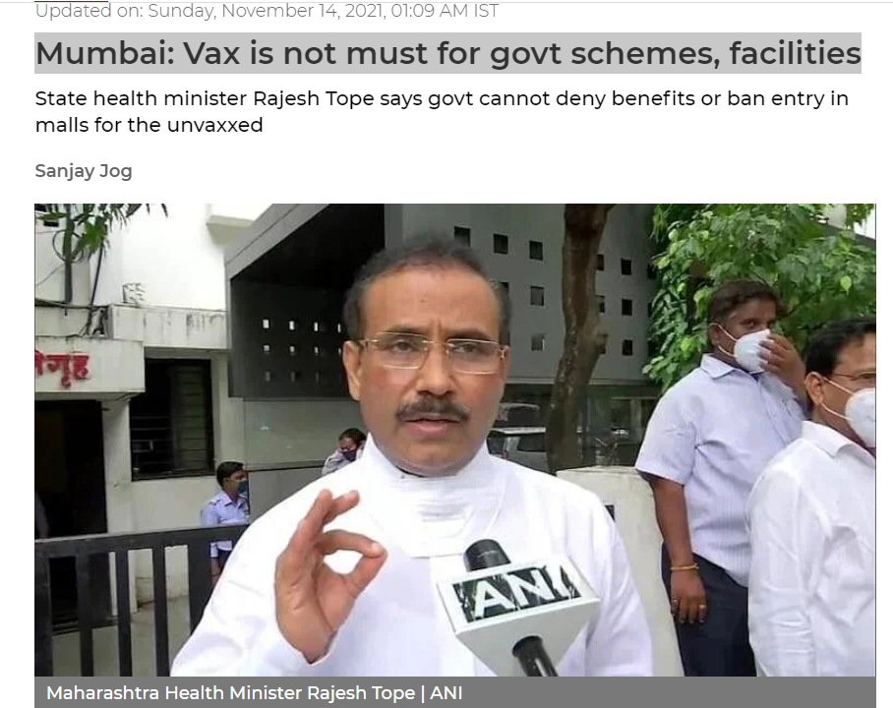
10. MUMBAI: VAX IS NOT MUST FOR GOVT SCHEMES, FACILITIES
Link: https://www.freepressjournal.in/mumbai/mumbai-vax-is-not-mandatory-to-avail-facilities-tope

Slide 22
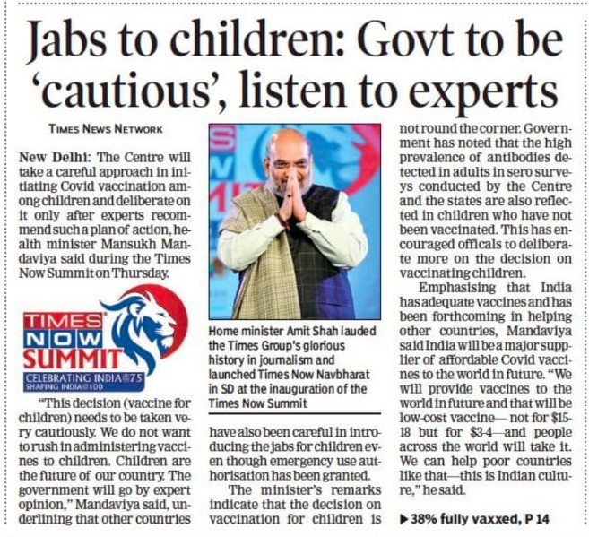
11. JABS TO CHILDREN: GOVT TO BE ‘CAUTIOUS’,LISTEN TO EXPERTS
Published in Times of India (Mumbai Edition) November 12, 2021

Slide 23
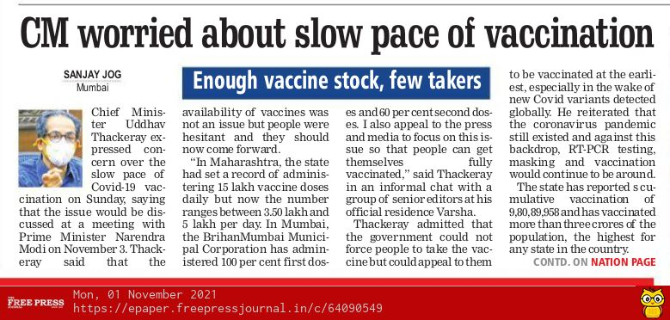
12. CHIEF MINISTER, MAHARASHTRA IS WORRIED ABOUT SLOW PACE OF VACCINATION
Link: https://epaper.freepressjournal.in/c/64090549

Slide 24
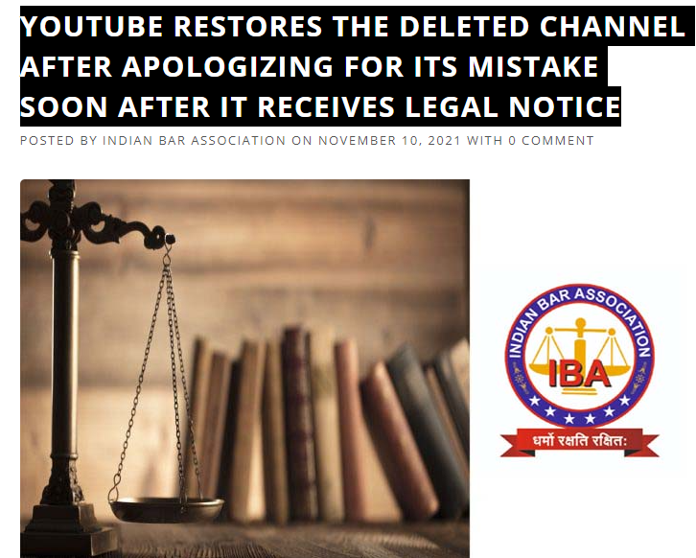
13. BIG WIN OVER BIG TECH CENSORSHIP
Read the blog here: https://indianbarassociation.in/youtube-restores-the-deleted-channel-after-apologizingfor-itsmistake-soon-after-it-receives-legal-notice/

Slide 25
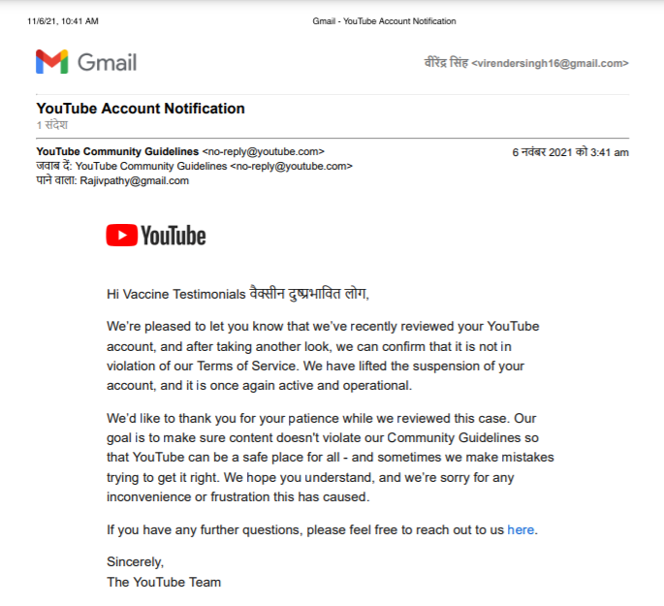
EMAIL RECEIVED FROM YOUTUBE

Slide 26
Thank You

